Slide 1
The Untapped Pipeline of the Cybersecurity Industry
Reflections on Cyber Clubs Steven Ngo / stengo
October 18, 2025

Slide 2
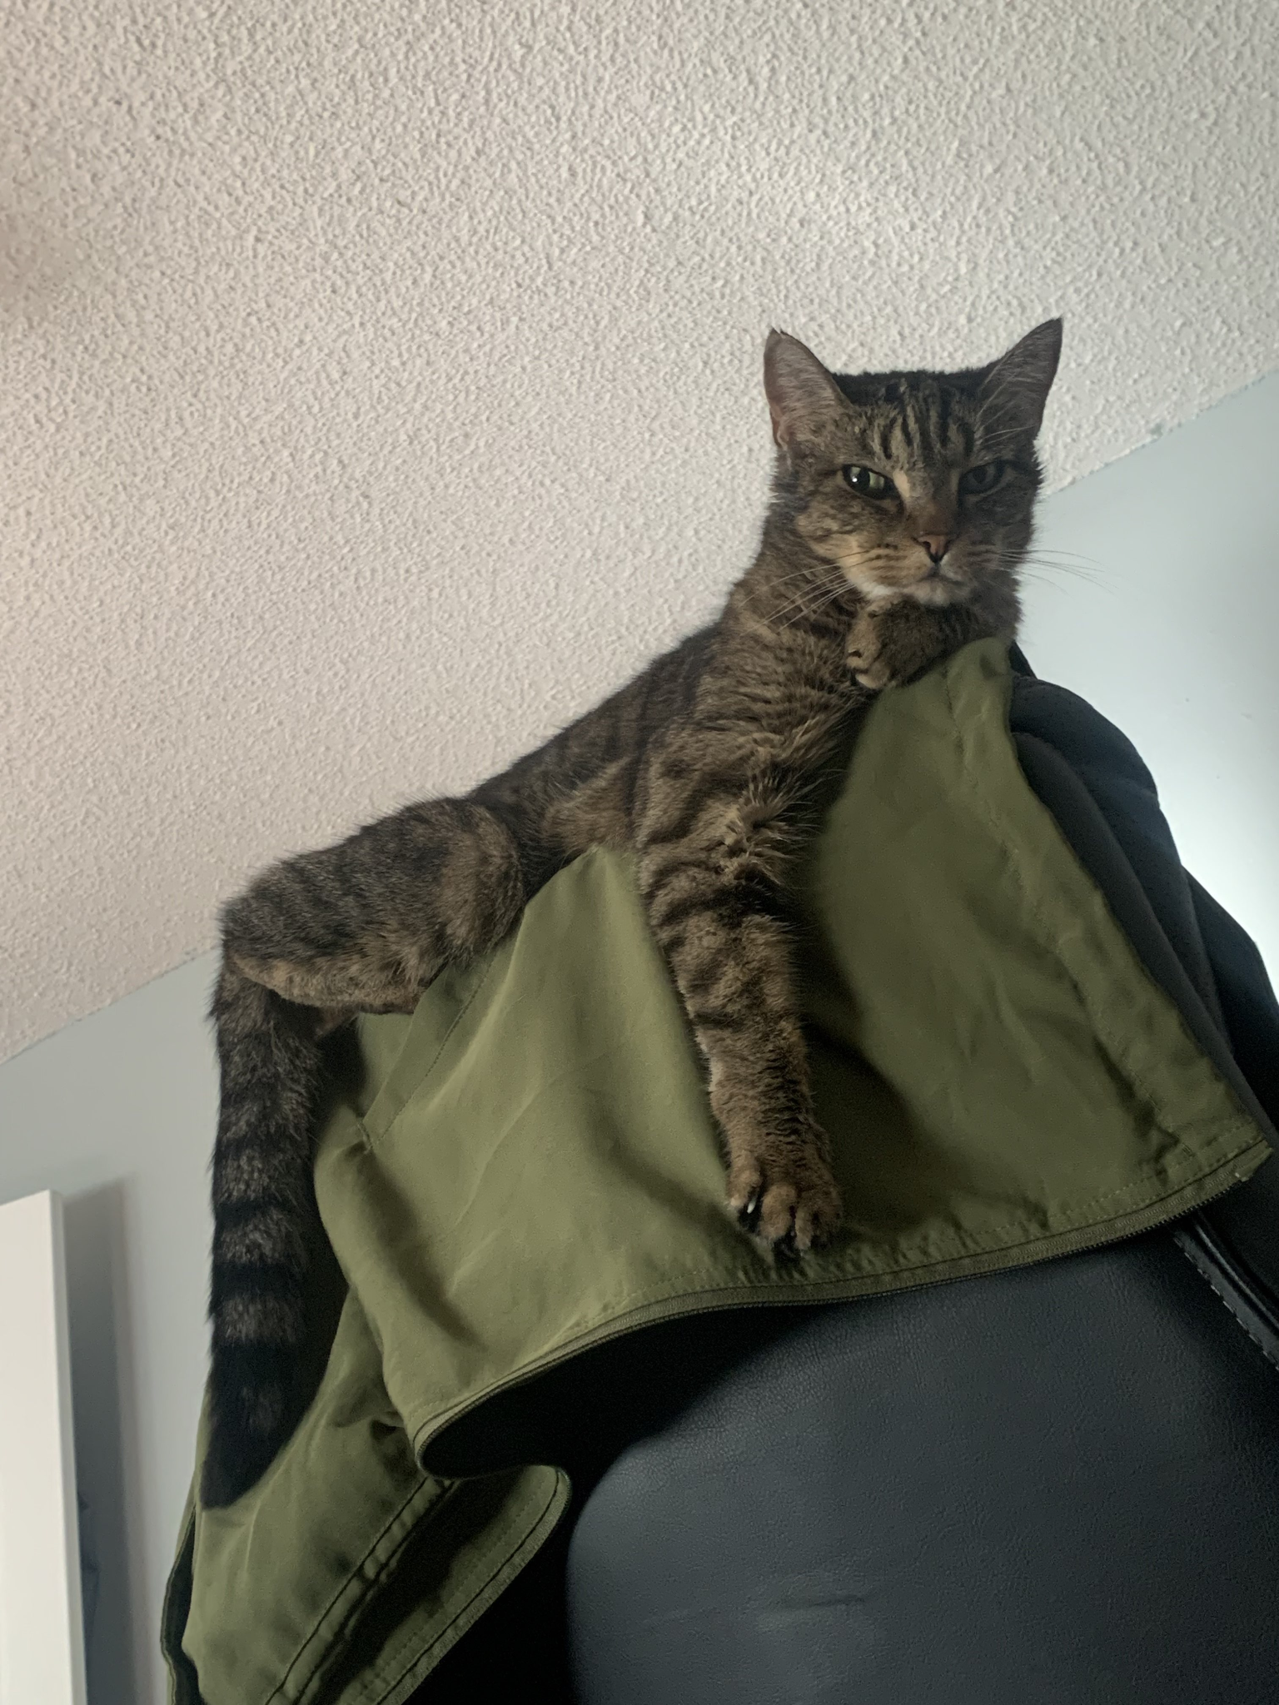
whoami
3rd-year Software Engineering Ph.D. student @ UC Irvine Broadly interested in research in software security, developer-centered security, and SWE + security education
President of Cyber @ UCI President since Spring ‘24 (took over in the spring of my 1st year) Previously ran the cybersecurity club at Cal Poly SLO
Director of Academic Outreach with the National Upcycled Computing Collective (NUCC) “Officially” appointed in August ‘25
Honey

Slide 3
Raising Awareness For...
College-level cybersecurity clubs, typically fully ran by students
Benefits that these groups bring to their campus and institution and the security community + industry
Challenges that these groups face while going after objectives that ultimately benefit the security community + industry
Current points of ‘discussion’ and how you can support these groups

Slide 4


Positionality Statement
Have experienced being a leader in two different security clubs
1 at a teaching-focused institution, 1 at a research-focused institution
Only within California; not fully aware of how things are outside of CA
Research time is currently invested into security education – I focus a lot more on how security education is currently happening than most
Thinking about it more in terms of research questions + publications, not necessarily to create a ‘product’ or provide a ‘paid service’
Limited experience with ‘real-world’ security; any experiences are at large tech companies
Would love to learn more about your perspectives!

Slide 5
What Are Cybersecurity Clubs?
Student-ran organization on a college campus that typically focuses on:
General exploration of security careers and fields
Security awareness for the greater community + letting students know about a potential career path
Security education for others (e.g., workshops)
Facilitating participation in competitions → CTFs, CCDC, CPTC, etc...
Local community for students who are interested in security
Usually does have a university faculty/staff serving as an ‘advisor’

Slide 6
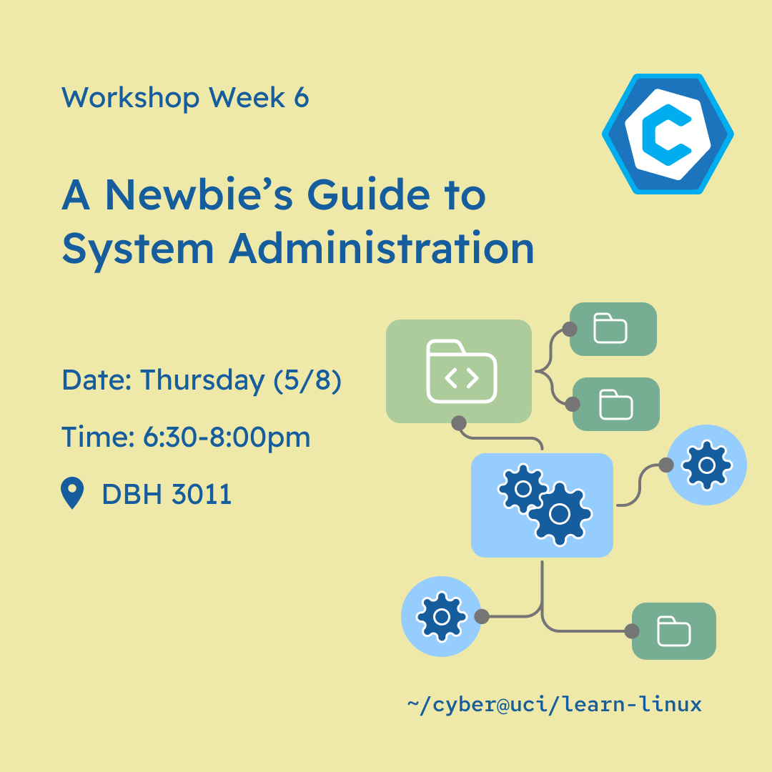
More Concrete Activities
Weekly workshops
Guest speaker presentations
Resume reviews and mock interviews
Social activities
Open “office hours”
Competitions (CTFs, CCDC)
Research projects

Slide 7
Overarching Goals
Members (and really, students) want cool jobs that pay well + stable
By extension, they want skills and experiences that make them marketable / hirable / AI-proof
Members want to grow the club – convince more students to join, develop more ways for others to get involved, increase awareness and visibility for the club around campus
Or at the very least, have a foundation to “maintain” things for the long run

Slide 8












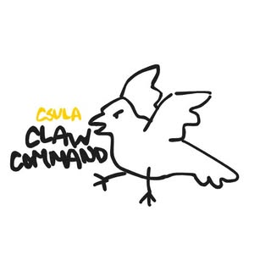



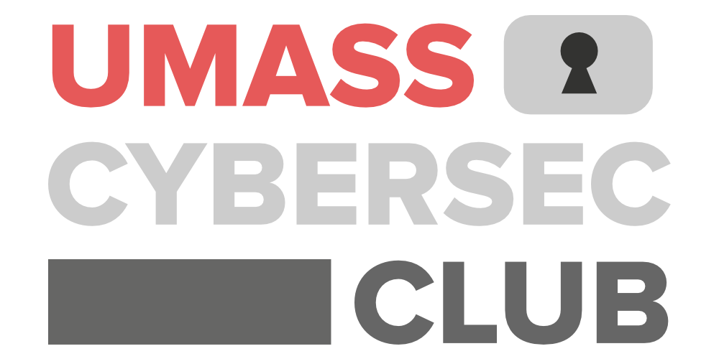

Slide 9
State of Security in School
For most CS degrees, little to no applied security education in the curriculum
Not enough bandwidth to slot more content into a degree, especially amongst other competing priorities
Have to teach a lot of the fundamentals of CS/SWE before tackling anything like security engineering, application security, cloud security
Few schools have professors who are teaching non-introductory security courses
If any, it's more along the lines of computer & network security, software security, reverse engineering/binary exploitation
May be locked behind prerequisites; can’t take them until junior or senior year
At R1 universities, tenure-track professors are primarily focused on their research

Slide 10
State of Security in School
There are security classes that are introductory, but often paint an incorrect picture of security in the real world
“theoretical focus on cryptography”, “oversimplified and tedious assignments”
Some classes end up getting mistaken as ‘this is what security looks like’
Some of these even end up scaring people away and make them think “I never want to interact with security…”

Slide 11
Benefits

Slide 12
No Courses? No Problem!
Viable path for security education for those who are interested in the space (but there aren’t any readily available courses)
You learn bit by bit through attending general workshops, but it really picks up when you….
Join some kind of competition / project / research team
Ask more senior members for advice on where to start (and mentoring)
“Osmosis” from being around the community
Spontaneous discussion on someone’s latest project or recent news
“I have this interview coming up… any thoughts on how I should prepare?”

Slide 13
Resume Building & Interview Story Farming
You gotta fill out your resume somehow… (again, how are you supposed to get “experience”?)
Projects from courses that were assigned <<< projects you purposefully got involved in within your local cyber club
Board member positions (+leadership), involvement in a small team (+teamwork)
Doesn’t have to be strictly security-related!
Outreach, design, social media, event organization
Don’t underestimate the value of your accomplishment with stuff unique to cyber clubs
Hosting a regional conference led entirely by students…
Participating in a nationally-recognized cyber defense competition
Makes for excellent stories to tell in interviews and answers for behavioral interview questions!

Slide 14


Space and Community
How else do people with an interest in security or people looking to learn more connect with one another?
Official recognition as a club on-campus and structure allows people to find others with like-minded interests
Host competition teams, certification study groups, mentorship programs
Unique to us: access to some of the more thriving cybersecurity professionals and hacker communities in the country in SoCal (IVU, OC2600)
If it’s intimidating to go all on your own, then go with your clubmates!
Volunteering opportunities to attend security conferences for free!

Slide 15
“Unstructured Tinker Time”
Your school assignments are often very specific, with provided test cases (“guardrails” for a course environment)...
Not really supportive of the real world, where you get given more vague details for you to parse through (and trial & error through…)
Cyber clubs allow for more open-ended skills development, ‘tinkering’ around in an ‘unstructured’ fashion
“Here’s this router, try to do this with it…”

Slide 16
Some Generalized Anecdotes
First years w/ very minimal experiences in CS & cybersecurity → Contributing team members in competitions, board, and project teams
There’s definitely a learning curve, but far from impossible (takes some grit and failure)
Cybersecurity is not always for everyone, but a cyber club often becomes a prominent “gateway” into the field for their campus
Classes are one thing, but how about the community?
Physical computing infrastructure being a very unique allure that other CS clubs and subdisciplines don’t offer
“Plop a server right in front of someone, and open it up…”
Consistent involvement → ‘free’ registration for DEFCON, LayerOne, BSides
IVU and OC2600 organizers are long-time DEFCON attendees with volunteering opportunities

Slide 17
Challenges

Slide 18
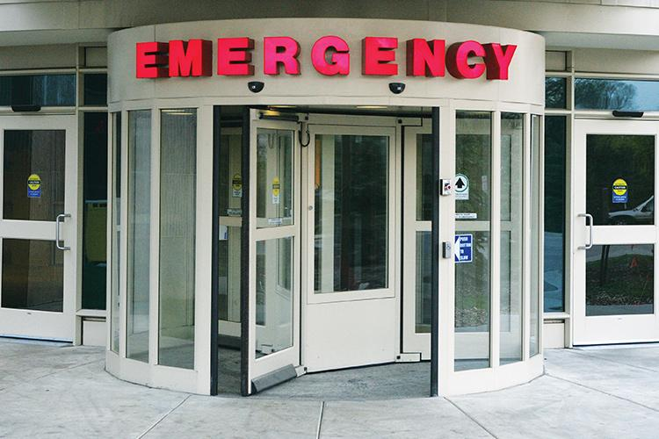
The “Revolving Door”

Slide 19
The “Revolving Door”
Constant rotation of leadership w/o any stability
Board members / leads typically only serve for ~1-2 years, and then graduate
Best practices and lessons learned aren’t always necessarily passed down…
Members come in and out, typically no commitment required
Incentive to stick around has to come from within - no “mandatory attendance” or “grades” or “payment”
People explore different clubs, get really busy with classes, want to hang out more with friends, etc

Slide 20
Varying Faculty/Staff Support
These are the stability that clubs need – but finding a committed one can be difficult…
At a research-focused institution, faculty’s main incentive == research; not as involved with the day-to-day to really oversee growth
Ultimately, still has to be led by students, but proper guidance and having the right connections can go a long way

Slide 21
“Blind Leading the Blind”
Students with minimal real-world experience in security themselves helping educate others in the discipline
They do what they can… Goes to show how much effort students put in to be a lead
Wide range of people who step up - some did CTFs in high school, some haven’t touched security until they joined the club + really liked it
More senior members may be relying on internship experience, “tribal knowledge” being passed down (e.g., reusing workshop materials
Guest speakers help a lot in this aspect, but not always easy to find

Slide 22
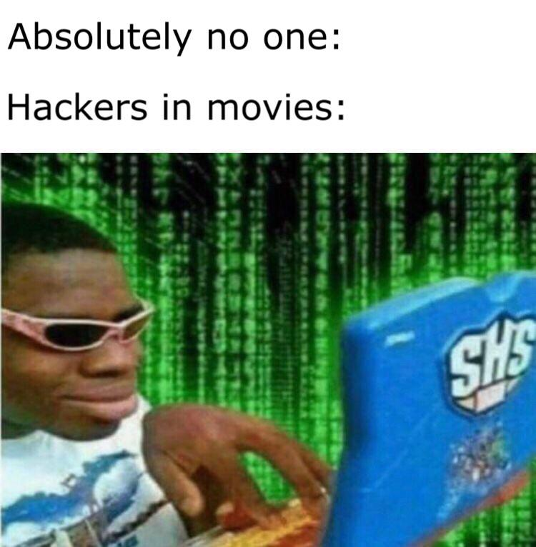
“Security is Scary”
Multiple factors that contribute to security being viewed as scary by others:
Classes and curriculum not really baking in the fundamentals
Often requires fundamental knowledge elsewhere
Other classes get labeled as ‘this is security’ despite not providing a proper view of what’s available within the field
At the end of the day, is a difficult field
And even in tech, often is a team that “blocks” progress…
Popular media and culture also doesn’t paint the field in a light that makes it as appealing as some of the other hotter topics in CS

Slide 23
Developing Engaging & Interesting Content
A lot of cool, impactful, interesting stuff in security →
Finding vulns/CVEs, reversing malware, tooling and defenses, tracking threats, forensics, pentesting/red teaming
And so on…
But how do we teach it?

Slide 24
Open Questions
How do clubs align what they do to best prepare students for careers in security while also developing engaging content?
What kinds of projects or club offerings get people to stick around the most?
Also ties into club culture, just being friendly and welcoming
Should clubs be cold-emailing companies for sponsorships, guest speaker engagements, collaborations, etc., or is there a more refined way to connect?
How do clubs make security not as scary as it is (on par with other CS disciplines at least) and attract more members?
Also acknowledging that it’s not for everyone, can’t retain everyone

Slide 25
Solutions...?

Slide 26
Succession Planning
Though, planning for the future of the club isn’t always at the top of an undergraduate student’s minds…
Finishing up their degree, internships, interviewing for full-time positions, social life
The club itself doesn’t pay them anything…
What’s the most lightweight method of succession planning / leadership continuity that can be adapted in a variety of situations?

Slide 27
Alumni “Councils” / “Advisory Boards”
Anecdotally, some cyber clubs (e.g., RITSEC) have been able to have long-standing success due to their alumni support
Need for an “official” mechanism to engage with alumni, whether they just graduated or have been out for 10+ years
They have insight into current trends in industry and lessons learned from when they were a part of club (ideally, also leadership)
If you can make it look official/professional, it also looks good when trying to also get sponsors and mentors

Slide 28
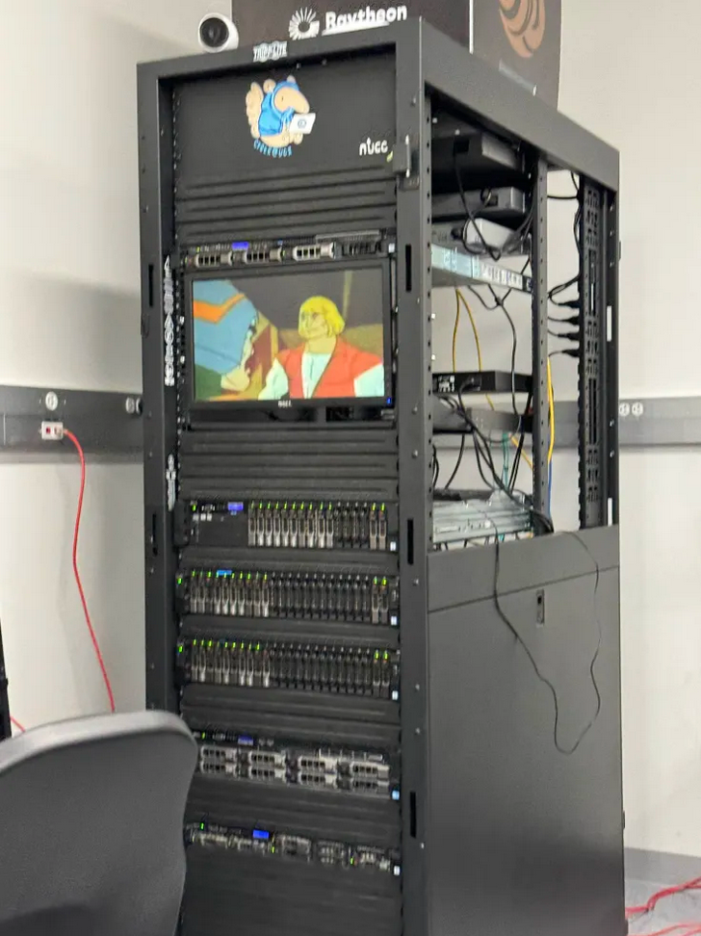
The National Upcycled Computing Collective
NUCC: SoCal-based non-profit that “upcycles” computing equipment and hardware for research, education, and outreach purposes focused around security and hacking
Starting in 2022, got roped into security education by supporting UCI with their own server infrastructure

Slide 29
SoCal Cyber Clubs & Untitled Infra Server
These are student-/alumni-led Discord servers where many of the club leadership across cyber clubs in California are in and chat a lot with each other
Serves as a “network” of cyber clubs….
UC campuses: Irvine, Davis, Santa Cruz, Riverside, Los Angeles
CSU campuses: Fullerton, San Bernardino, Los Angeles, Long Beach, Northridge
Community colleges too!
Great place to share events, ask for ideas and advice, and also expand your own network!

Slide 30
Rallying Support

Slide 31

“Spare change, ma’am?”

Slide 32
They Really Do Care!
Students may be hesitant to reach out or send a cold email, or simply not know who to reach out to
Being a board member isn’t their day-to-day…. But ultimately they care about security and can become a vital part of the community

Slide 33
Your Mileage May Vary
Different clubs have different needs…
Some need A LOT more funding and resources to operate properly
Some want help with developing pipelines for internships/full-time jobs to attract members
Some want to figure out what they should be teaching to best prepare students for real-world security jobs
Some want some project and research ideas
Some just need guest speakers to flesh out their workshop schedule

Slide 34
Supporting Your Local Club
Some ways you can help:
Reach out to them first! Offer whatever you can based on your availability
Guest speaker engagement
Continued mentoring
Connection with your employer → sponsorships, internship pipelines, visibility
Advice to do XYZ
Coaching for a competition team
Offering your support for when they advocate for more resources on campus

Slide 35
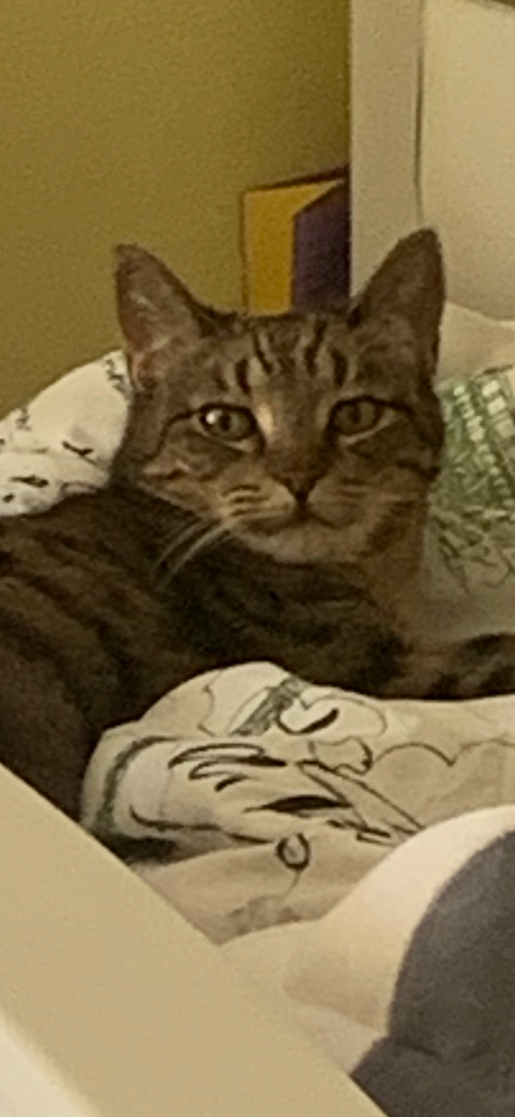
Thanks! Reach out:
School Email - skngo1@uci.edu
NUCC Email - stengo@nuccinc.org Discord - stengo

